Slide 1
Chapter outline
Sources and Uses of Cash
Standardize financial statements for comparison purposes.
Compute and interpret some common ratios.
    We will not cover ratios in detail
Explain some of the problems and pitfalls in financial statement analysis.

Slide 2
Cash flow and financial statements: A closer look
Activities that bring in cash are called sources of cash, while activities that involve spending cash are called uses of cash.
An increase in a left-side (asset) account or a decrease in a right-side (liability or equity) account is a use of cash.
  Increase in an asset account means the firm, on a net basis, bought some assets – a use of cash.
A decrease in a left-side (asset) account or an increase in a right-side (liability or equity) account is a source of cash.
Decrease in an asset account, on a net basis, means the firm sold some assets (that is, a net source).
To trace the flow of cash through a firm during the year in a detailed fashion, we need two-year balance sheets and an income statement.

Slide 3
Prufrock corporation: 2020 and 2021 balance sheets 1
PRUFROCK CORPORATION 2023 and 2024 Balance Sheets (in $ millions)
 | 2023 | 2024 | Change
 | Assets
Current assets
Cash | $ 84 | $ 146 | +$ 62
Accounts receivable | 165 | 188 | + 23
Inventory | 393 | 422 | + 29
Total | $ 642 | $ 756 | +$114
Fixed assets
Net plant and equipment | $2,731 | $2,880 | +$149
Total assets | $3,373 | $3,636 | +$263

Slide 4
Prufrock corporation: 2023 and 2024 balance sheets 2
PRUFROCK CORPORATION 2023 and 2024 Balance Sheets (in $ millions)
 | 2023 | 2024 | Change
 | Liabilities and Owners’ Equity
Current liabilities
Accounts payable | $ 312 | $ 344 | +$ 32
Notes payable | 231 | 196 | − 35
Total | $ 543 | $ 540 | −$ 3
Long-term debt | $ 531 | $ 457 | −$ 74
Owners’ equity
Common stock and paid-in surplus | $ 500 | $ 550 | + $ 50
Retained earnings | 1,799 | 2,089 | + 290
Total | $2,299 | $2,639 | +$340
Total liabilities and owners’ equity | $3,373 | $3,636 | +$263

Slide 5
Prufrock corporation: summary of sources and uses of cash
Sources of cash:
Increase in accounts payable | $ 32
Increase in common stock | 50
Increase in retained earnings | 290
Total sources | $372
Uses of cash:
Increase in accounts receivable | $ 23
Increase in inventory | 29
Decrease in notes payable | 35
Decrease in long-term debt | 74
Net fixed asset acquisitions | 149
Total uses | $310
Net addition to cash | $ 62

Slide 6
Prufrock corporation: 2024 income statement
PRUFROCK CORPORATION 2024 Income Statement (in $ millions)
Sales |  | $2,311
Cost of goods sold |  | 1,344
Depreciation |  | 276
Earnings before interest and taxes |  | $ 691
Interest paid |  | 141
Taxable income |  | $ 550
Taxes (21%) |  | 116
Net income |  | $ 435
Dividends | $145
Addition to retained earnings | 290

Slide 7
The Accounting Statement of Cash Flows
There is an official accounting statement called the statement of cash flows. It summarizes the companie’s sources and uses of cash over a specified period.
This helps explain the change in accounting cash.
The three components of the statement of cash flows are:
  Cash flow from operating activities.
  Cash flow from investing activities.
  Cash flow from financing activities.

Slide 8
Prufrock corporation: Statement of Cash Flows
Cash, beginning of year | $ 84
Operating activity
Net income | $ 435
Plus:
Depreciation | 276
Increase in accounts payable | 32
Less:
Increase in accounts receivable | − 23
Increase in inventory | − 29
Net cash from operating activity | $ 691
Investment activity
Fixed asset acquisitions | −$ 425
Net cash from investment activity | −$ 425
Financing activity
Decrease in notes payable | −$ 35
Decrease in long-term debt | − 74
Dividends paid | − 145
Increase in common stock | 50
Net cash from financing activity | −$ 240
Net increase in cash | $ 62
Cash, end of year | $ 146
PRUFROCK CORPORATION 2024 Statement of Cash Flows (in $ millions)

Slide 9
Standardized Financial Statements
Nearly impossible to directly compare the financial statements for two companies because of differences in size.
  Similarly challenging to compare financial statements from different points in time for the same company if the company’s size has changed.
To make comparisons, standardize the financial statements:
  Common-size statements present all items in percentage terms.
    Common-size balance sheets typically express each item as a percentage of total assets.
    Common-size income statements usually show each item as a percentage of total sales.
    Common-size statement of cash flows can be constructed from a “sources and uses of cash” statement, expressing each item as a percentage of total sources (or total uses).
2. Common-base year statements (that is, trend analysis) present all items relative to a certain base year amount.

Slide 10
Prufrock corporation: Summary of standardized balance sheets
PRUFROCK CORPORATION Summary of Standardized Balance Sheets (Asset Side Only)
 | Assets (in $ millions) |  | Common-Size Assets |  | Common-Base Year Assets | Combined Common-Size and Base Year Assets
 | 2023 | 2024 | 2023 | 2024 | 2024 | 2024
Current assets
Cash | $ 84 | $ 146 | 2.5% | 4.0% | 1.74 | 1.61
Accounts receivable | 165 | 188 | 4.9 | 5.2 | 1.14 | 1.06
Inventory | 393 | 422 | 11.7 | 11.6 | 1.07 | 1.00
Total current assets | $ 642 | $ 756 | 19.0 | 20.8 | 1.18 | 1.09
Fixed assets
Net plant and equipment | $2,731 | $2,880 | 81.0 | 79.2 | 1.05 | .98
Total assets | $3,373 | $3,636 | 100.0% | 100.0% | 1.08 | 1.00
146/84 =
4%/2.5%=

Slide 11
Ratio analysis
Another way of avoiding the problems involved in comparing companies of different sizes is to calculate and compare financial ratios.
  Financial ratios are relationships determined from a firm’s financial information and used for comparison purposes.
Financial ratios are traditionally grouped into the following categories:
  Short-term solvency, or liquidity, ratios.
  Long-term solvency, or financial leverage, ratios.
  Asset management, or turnover, ratios.
  Profitability ratios.
  Market value ratios.
Different people and different sources seldom compute ratios in the same way, leading to confusion.

Slide 12
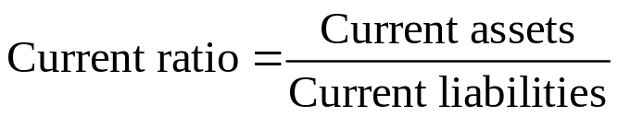
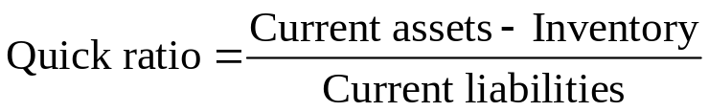
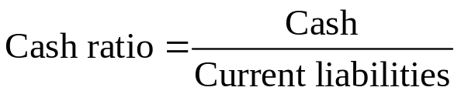
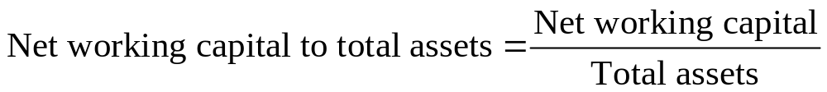
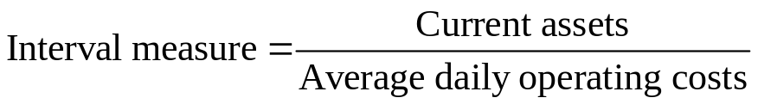
1. Short-term solvency, or liquidity, ratios

Slide 13
Short-term solvency, or liquidity, measures
Current ratio is a measure of short-term liquidity.
  To a creditor, the higher this ratio, the better.
  To a firm, a high current ratio may indicate an inefficient use of cash and other short-term assets.
  Normally expect to see a current ratio of at least 1.
Quick (or acid-test) ratio is computed just like the current ratio, except inventory is omitted since it is often the least liquid current asset.
  Relatively large inventories are often a sign of short-term trouble.
Cash ratio may be of interest to a very short-term creditor.
Net working capital to total assets.
  Low values might indicate relatively low levels of liquidity.
Interval measure indicates how long the business can continue.

Slide 14
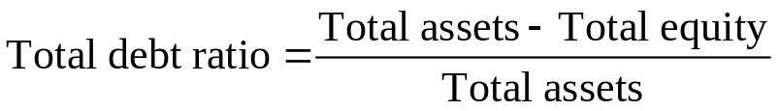
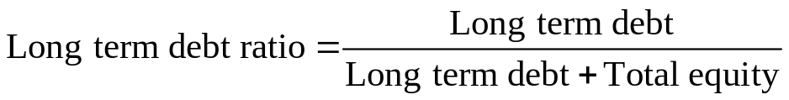

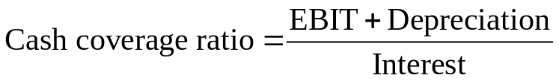
2. Long-term solvency ratios or financial leverage, ratios

Slide 15
Long-term solvency measures or financial leverage, ratios
Total debt ratio considers all debts of all maturities to all creditors and has two useful variations:
  Debt-equity ratio.
  Equity multiplier.
Long-term debt ratio is calculated as long-term debt divided by the sum of long-term debt and total equity.
Times interest earned (T I E) ratio measures how well a company has its interest obligations covered and is often called the interest coverage ratio.
Cash coverage ratio is a basic measure of the firm’s ability to generate cash from operations and is frequently used as a measure of cash flow available to meet financial obligations.

Slide 16
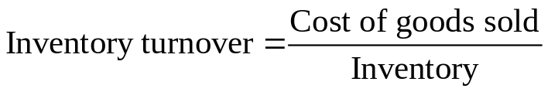

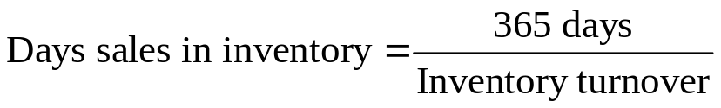
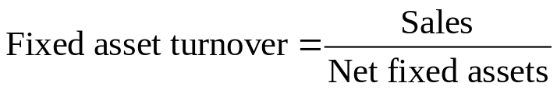
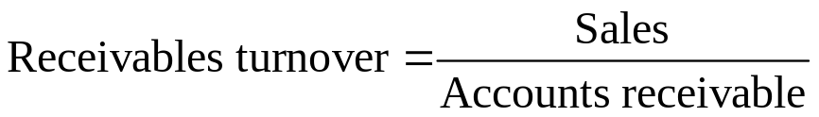
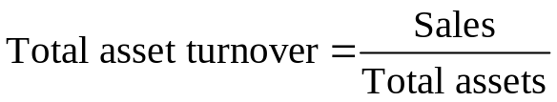
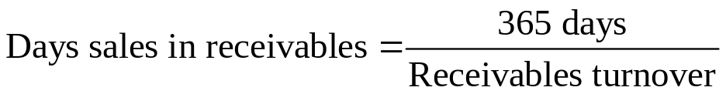
3. Asset management, or turnover, ratios

Slide 17
Asset management, or turnover, measures
Inventory turnover tells us how many times the firm sold off or turned over the entire inventory.
  Days’ sales in inventory tells us how many days inventory sits (on average) before it is sold.
Receivables turnover shows how many times a firm collects outstanding credit accounts and reloans the money.
  Days’ sales in receivables provides the average number of days it takes for a firm to collect on its credit sales.
  N W C turnover measures how much “work” we get out of our working capital.
  Fixed asset turnover tells us how much the company generates in sales for every dollar in fixed assets.
  Total assets turnover tells us how much the company generates in sales for every dollar in assets.

Slide 18
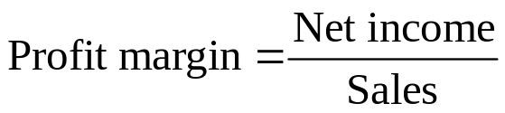
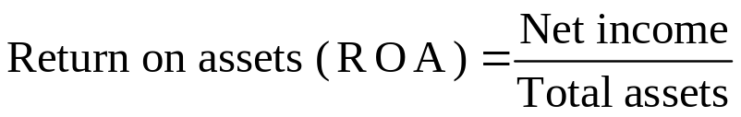
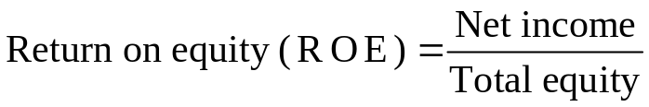
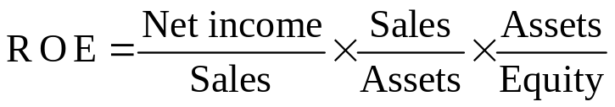
4. Profitability Ratios

Slide 19
Profitability measures
Profit margin measures how well a company makes money (that is, how much money it generates in profit for every dollar in sales).
  All other things equal, a relatively high profit margin is desirable.
  Significant variation in profit margins across industries.
  Return on assets (R O A) is a measure of profit per dollar of assets.
  Return on equity (R O E) is a measure of how the stockholders fared during the year (that is, how much money the company generated in profit for every dollar in equity).
  Remember that R O A and R O E are accounting rates of return; as such, they should properly be called return on book assets and return on book equity.

Slide 20
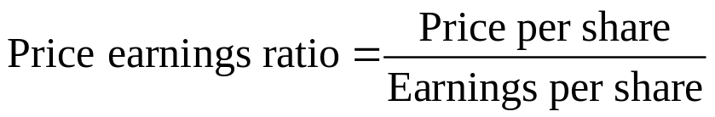
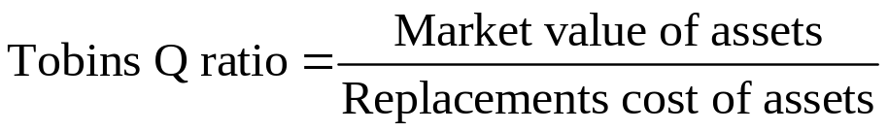
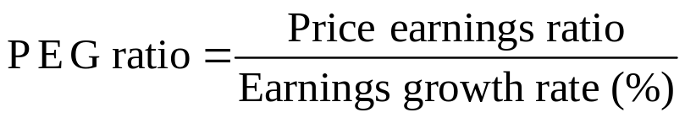
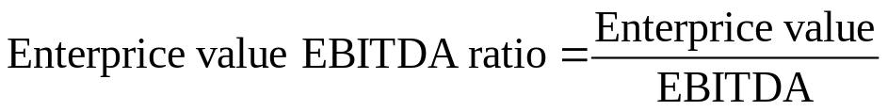
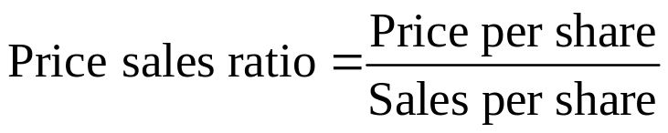
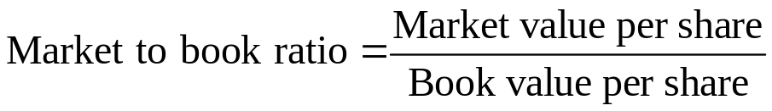
5. Market value ratios

Slide 21
Market value ratios
Price-earnings (P E) ratio measures how much investors are willing to pay per dollar of current earnings.
  Vary significantly across companies, but, in 2022, a typical large company in the U.S. had a PE in the 15 to 20 range.
  Higher P Es are often taken to mean the firm has significant prospects for future growth, but it could also mean a firm had no (or almost no) earnings.
Price-sales ratio is useful if P E ratio is not meaningful due (for example, firm has negative earnings for extended periods).
Market-to-book ratio compares the market value of the firm’s investments to their costs.
  Value less than 1 could mean that the firm has not been successful overall in creating value for its stockholders.
  Focuses on historical costs, which are less relevant.

Slide 22
Market value ratios
Tobin’s Q ratio is superior to the market-to-book ratio because it focuses on what the firm is worth today relative to what it would cost to replace it today.
  Firms with high Q ratios tend to be those with attractive investment opportunities or significant competitive advantages (or both).
  Difficult to calculate with accuracy because estimating the replacement cost of a firm’s assets is not an easy task and market values for a firm’s debt are often unobservable.
Enterprise value-E B I T D A multiple relates the value of all the operating assets (that is, enterprise value) to a measure of the operating cash flow generated by those assets (E B I T D A).
  Enterprise value is an estimate of the market value of the company’s operating assets, which include all assets of the firm except cash.

Slide 23
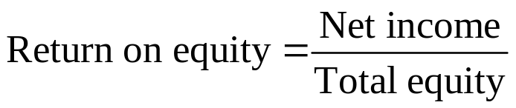
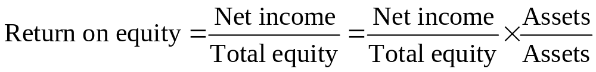
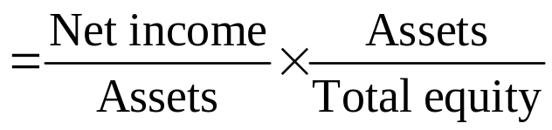
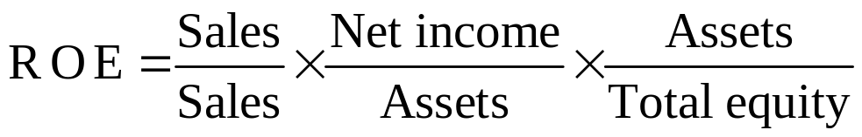
The DuPont identity 1
We could multiply R O E by Assets/Assets, which then expresses the R O E as the product of R O A and the equity multiplier:
We can further decompose R O E by multiplying by Sales/Sales:

Slide 24
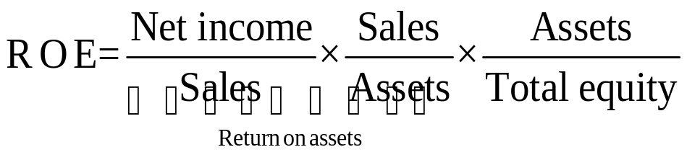
The DuPont identity
If we rearrange things a bit, we can partition R O A into its two component parts – profit margin and total asset turnover.
The DuPont identity breaks R O E into three parts:
  Operating efficiency, as measured by profit margin.
  Asset use efficiency, as measured by total asset turnover.
  Financial leverage, as measured by the equity multiplier.

Slide 25
Using financial statement information
Why evaluate financial statements?
  Internal uses include performance evaluation and planning purposes.
  Financial statements are also useful to parties external to the firm:
    Short-term and long-term creditors.
    Potential investors.
    Suppliers and large customers.
    Credit rating agencies.
    Competitors.
    Potential targets for acquisition.

Slide 26
Problems with financial statement analysis
No underlying theory exists to help us identify which quantities to look at and to use in establishing benchmarks.
Many firms are conglomerates, owning unrelated lines of business, and consolidated financial statements for such firms do not fit any neat industry category.
Major competitors and natural peer group members in an industry may be scattered around the globe.
  Financial statements from outside the U.S. do not necessarily conform to all G A A P principles.
Even companies that are clearly in the same line of business may not be comparable.
Different firms use different accounting procedures.
Different firms end their fiscal years at different times.

